Slide 1

ASTRA Zeneca

Slide 2
How Scores for Each Cell Line is calculated
Score
Evidence Score
Confidence Score
Similarity
Score

Slide 3
Evidence Score
RNA (Depmap) + Protein + HPA
Evidence Score
3
Exclusion Evidence Penalty
e – (ʎ X (Percentile of Exclusion Evidence Score))
Case 1: No Exclusion Gene
Net Evidence Score
Target Evidence Score
Case 2: Exclusion Exists
Net Evidence Score
Target Evidence Score
Exclusion Evidence Penalty

Slide 4
Similarity Score
Similarity Score
Score obtained per gene from the similarity matrix
Similarity Penalty
e – (ʎ X (Percentile of Exclusion Similarity Score))
Case 1: No Exclusion Gene
Net Similarity Score
Target Similarity Score
Case 2: Exclusion Exists
Net Similarity Score
Target Similarity Score
Similarity Exclusion Penalty

Slide 5
Confidence Score
RNA (Depmap) + Protein + HPA
Modality Score
IF the value is present it denotes to 1 or else 0
3
1
Agreement Score
IF the value is not present it is excluded from the variance count
1 + Var(RNA (Depmap) + Protein + HPA)
Modality Score + Agreement Score
Confidence score
2

Slide 6
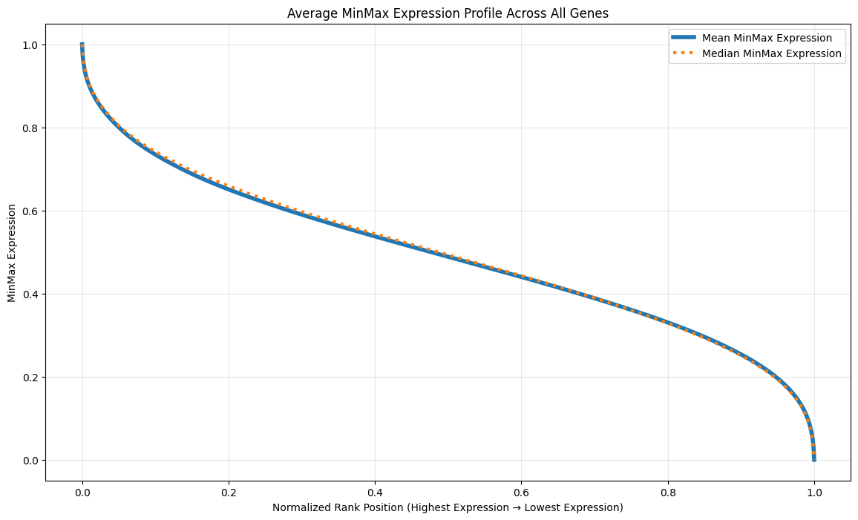
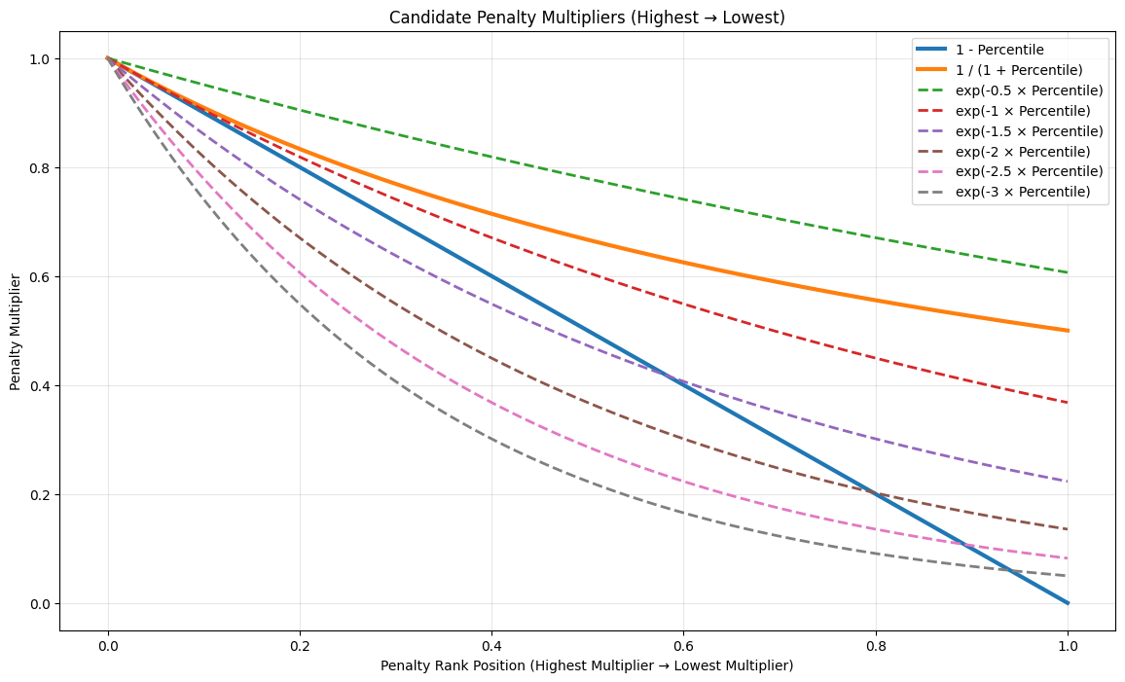
Arrival of the Formula
Gene Expression Curve across all the cell lines
Penalty Equation Curve

Slide 7
TEST RUN
The Input parameters from the user end
Target Genes => The genes which we are targeting
Exclusion Genes => The genes which needs to be excluded (lower expressions on the cell lines)
Disease (Optional) => Type of disease we are targeting for the cell line. Default is to consider all
Fusion Filter (Optional) => Indicator says if the fusion is required or not. Default is ignore and consider all
Mutation Filter (Optional) => Indicator says if the mutation is required or not. Default is ignore and consider all
For the test run below genes were selected for target and exclusion
Target genes => 'MTMR7', 'FKBP4', 'GGCT’
Exclusion genes => 'UPP2’
Disease => None
Fusion Filter => Ignore
Mutation Filter => Ignore

Slide 8
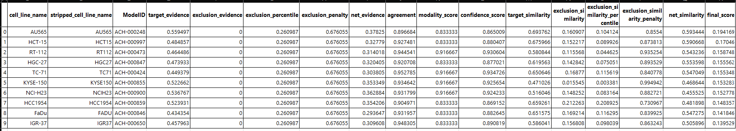
TEST RUN RESULTS
Top 10 Cell Lines

Slide 9
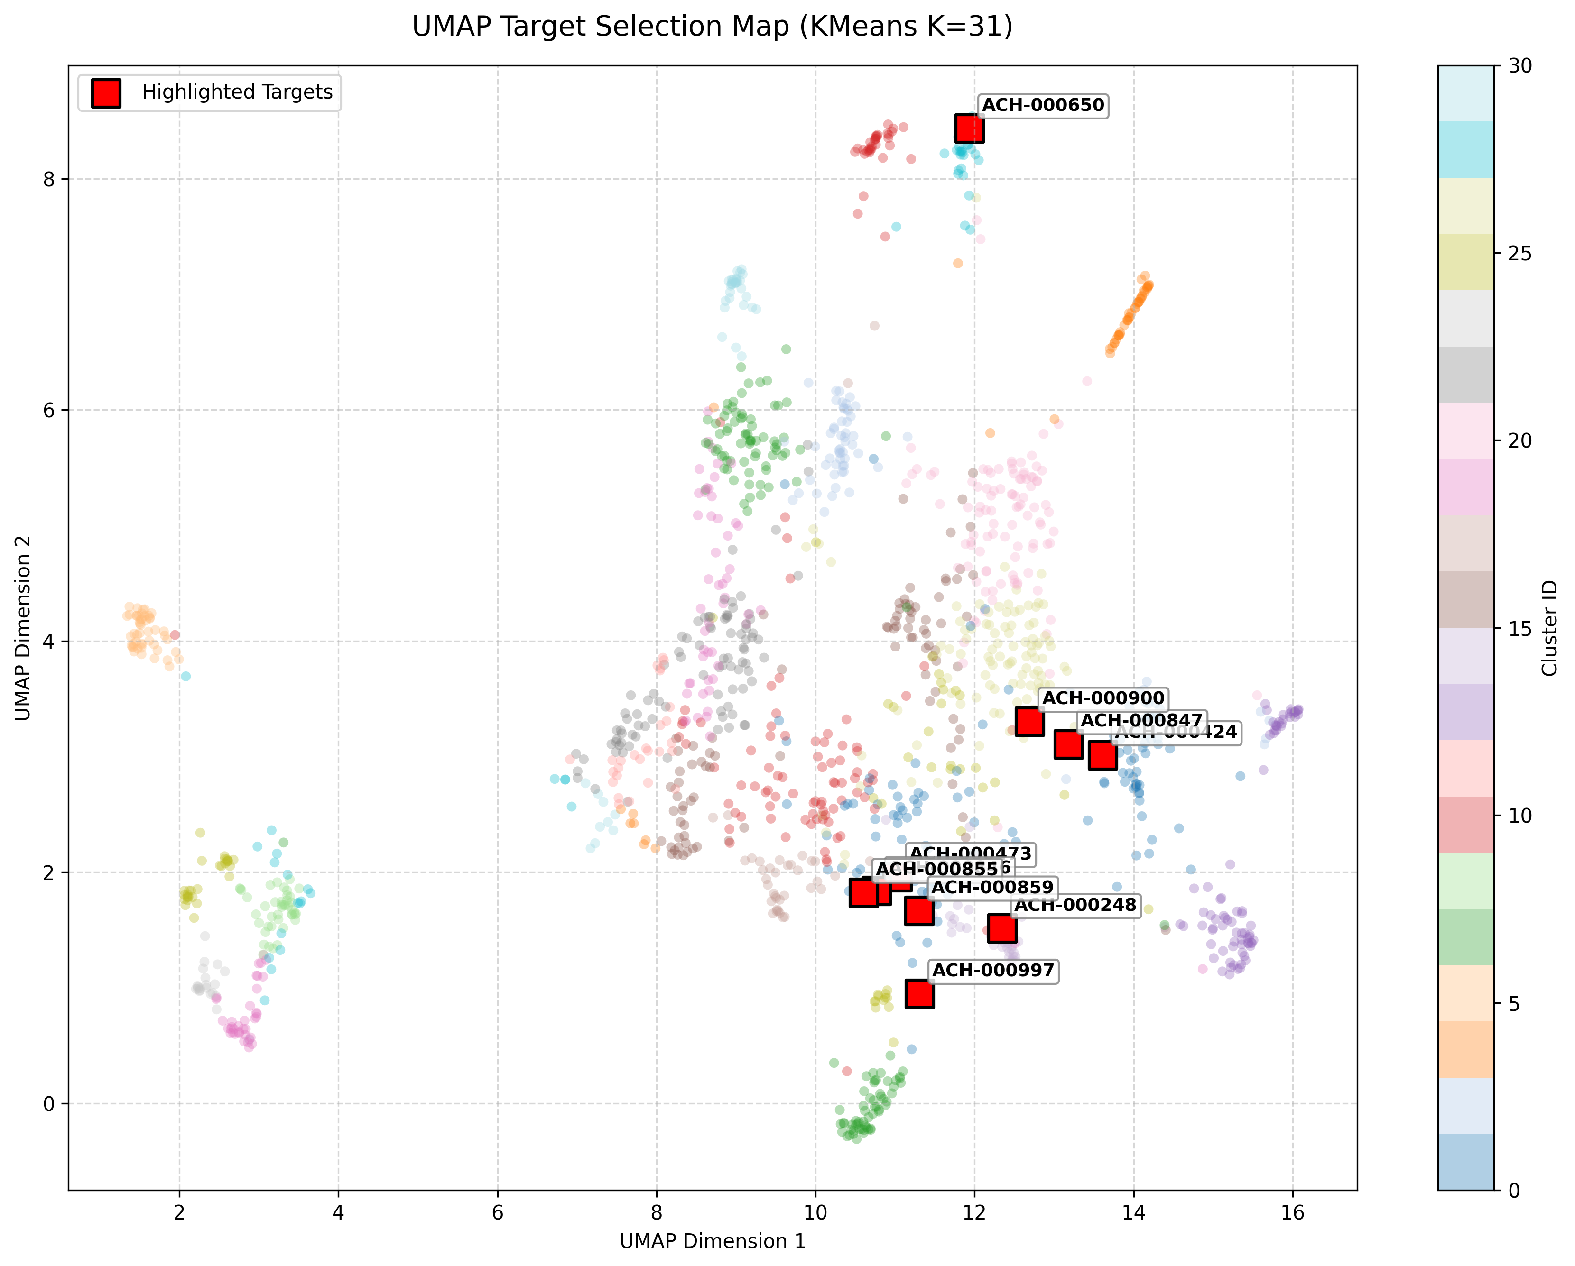
TEST RUN RESULTS
Top 10 Cell lines in the biological space

